Slide 1

AI in Entertainment and Media
June 25, 2025
by Michael Garcia, Hashim Sayed Hoosini, Miguel Mora

Slide 2
Domain Overview & Importance
Entertainment includes film, music, games, and digital media.
Media covers news, publishing, and broadcasting.
Industry serves billions and evolves rapidly.
Personalized content is now the norm.
AI drives creativity, efficiency, and engagement.
Data is central to modern media production and delivery.

Slide 3
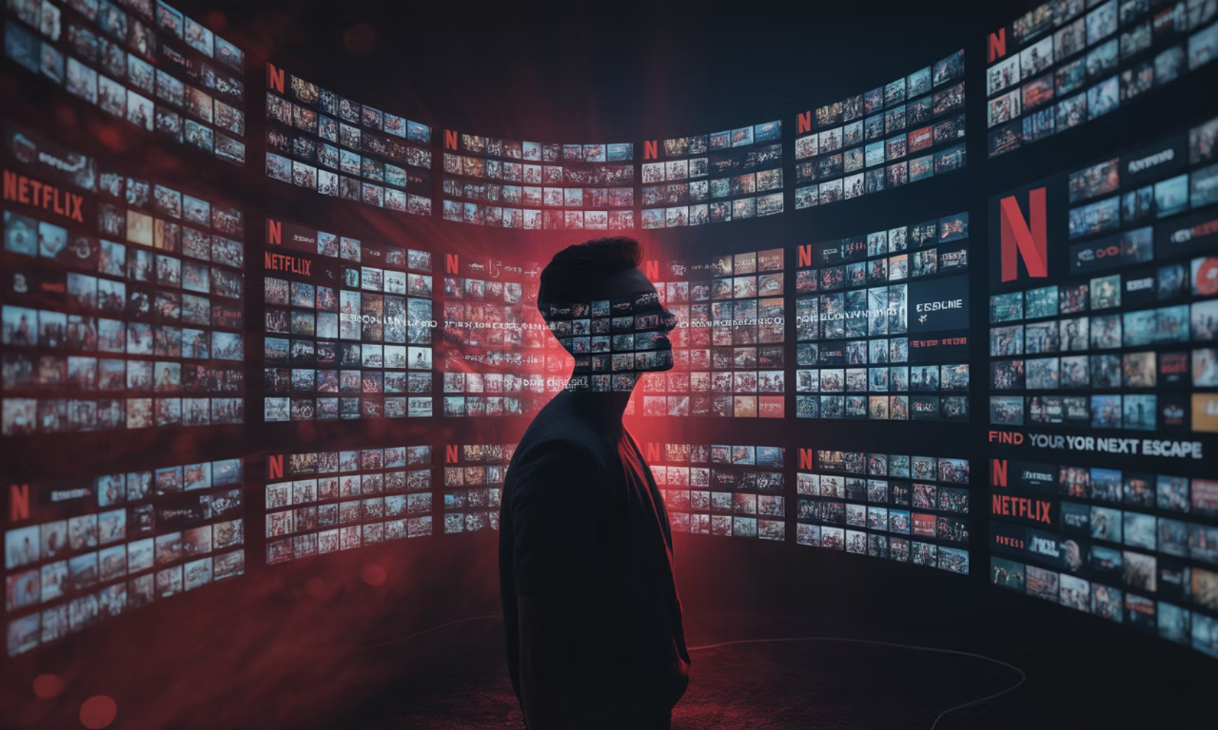
AI Use Case Motivation
Content overload requires smarter curation.
Manual editing and production are slow.
Viewer attention spans are shorter than ever.
Creators need insights on audience preferences.
AI personalizes, automates, and scales content delivery.
Example: Netflix's AI recommends shows to over 200 million users daily.

Slide 4






AI Techniques Used
Machine Learning (ML)
Natural Language Processing (NLP)
Predicts viewer preferences and trends.
Analyzes scripts, subtitles, and feedback.
Computer Vision
Deep Learning
Powers visual effects and content moderation.
Enables music generation and deepfake creation.
Generative AI
Recommendation Engines
Creates art, voices, and video content.
Tailor content to individual users.

Slide 5
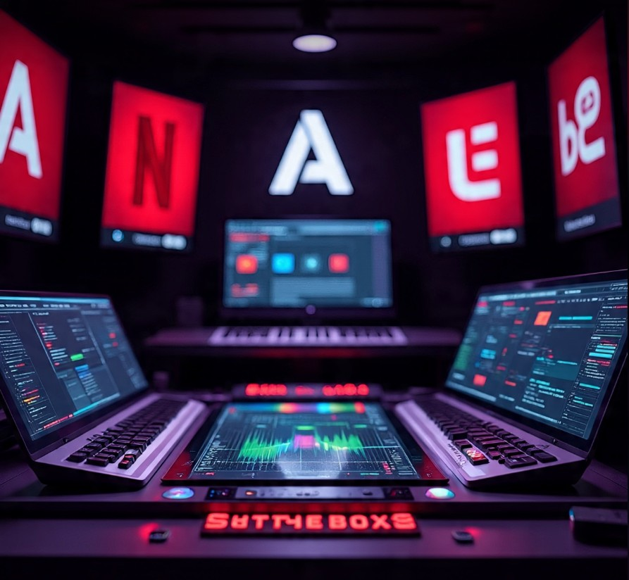





Key Applications
Netflix
ML-based show recommendations and thumbnail testing based
On your habits and what thumbnails you click the most.
YouTube
NLP moderates comments and recommends videos based on
Behavior and scans comments by using context-aware moderation
OpenAI's Jukebox
Generates music in various styles by learning patterns in real songs
And then generating new ones that sound like different genres.
Adobe Sensei
Automates editing and tagging in media by recognizing objects ,
scenes and actions.
Synthesia
Creates AI-generated video presenters by turning a written script
Into a lifelike avatar that speaks naturally, using text-to-text speech.
AI enables new formats like interactive storytelling and virtual concerts.

Slide 6
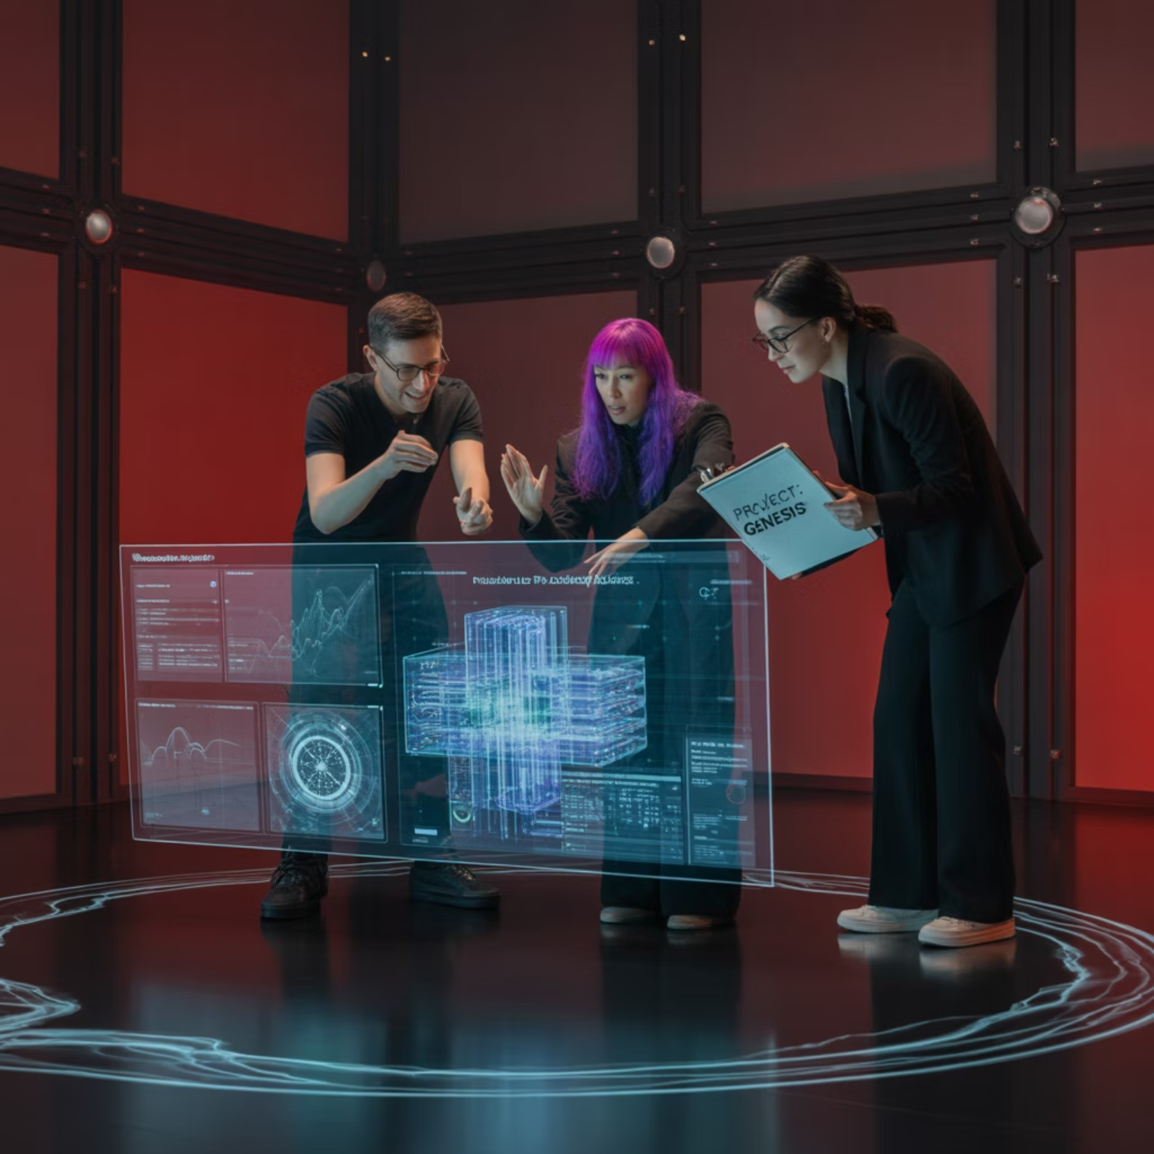
Impact & Benefits
Faster video and Audio production.
Lower cost, up to 90% using platforms such as Synthesia.
Personalized content boosts viewer retention and satisfaction.
AI expands access to creative tools for all users, making it easier and cheaper.
Enhance accessibility, subtitles, voice dubbing, and visual description.
Streamlined editing and post-production workflows.
New formats emerge, and AI-generated influencers.

Slide 7

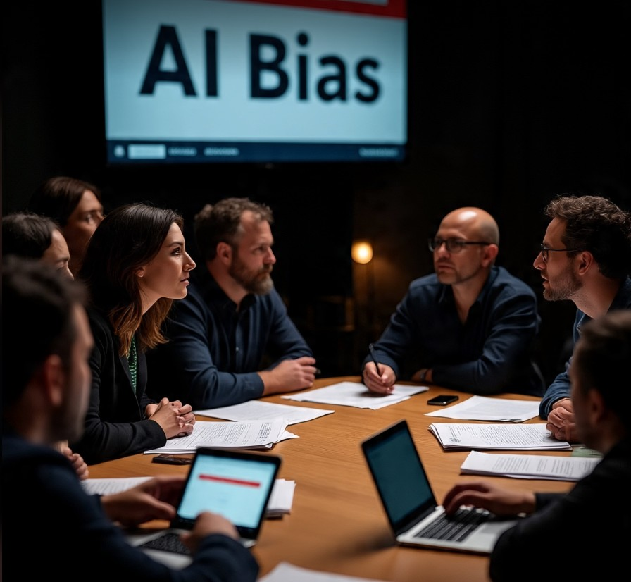

Challenges & Risks
Bias in AI models may reinforce stereotypes in content recommendations or generating art, such as generating art of mechanics only being men.
Data privacy issues: User behavior and preferences are consistently tracked and analyzed.
Job displacement and automation threaten roles in editing, music, journalism, and design.
Misinformation Via deepfake, AI can create convincing fake content that misleads viewers.
Lack of transparency in AI decisions and recommendations makes it hard to explain.
Legal uncertainty, copyright, and ownership of AI-generated content remain unclear

Slide 8
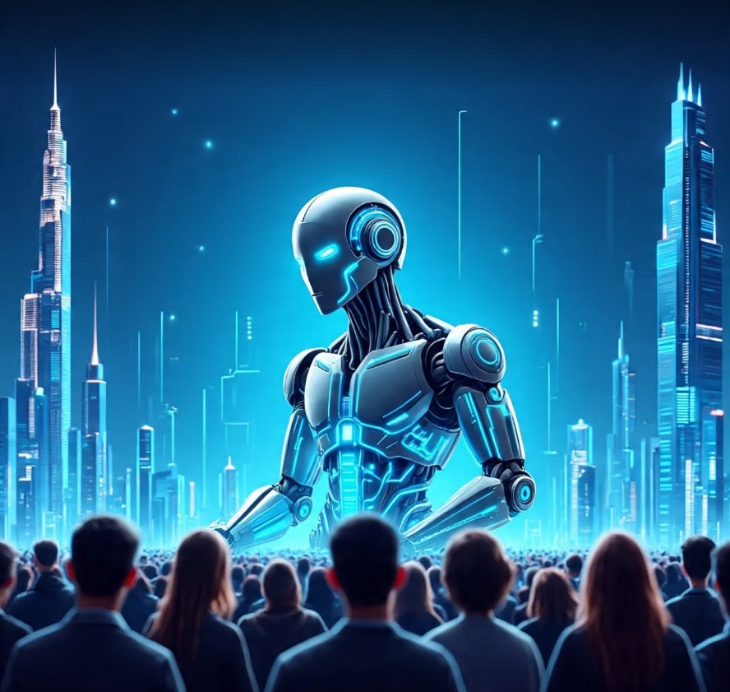
Future Directions
Multimedia AI Tools combining text, audio, and video for seamless content generation.
Real- time personalization instant adaption of content based on mood or reaction.
Ethical AI frameworks prioritize fairness, transparency, and accountability.
AI in live performance, real-time avatars, virtual concert, and dynamic stage visuals.
Collaborative creativity: Human-AI co-writing, co-composing, and co-designing.
AI-generated universes, expanding metaverses with AI-created characters and storylines.

Slide 9

Interactive Slide / Demo

Slide 10
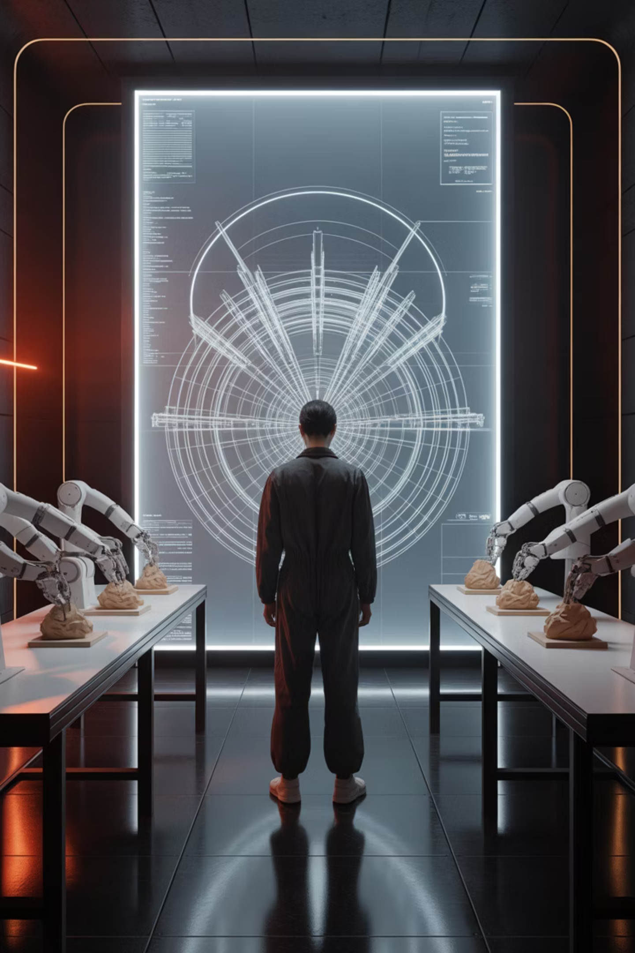
Conclusion
AI’s Role in Shaping Modern Media
AI transforms how the content is created, personalized, and consumed.
AI boosts efficiency, creativity, and audience engagement.
Key tools enable music generation, video generation, editing, and creating virtual storylines.
Challenges like bias, deepfakes, and job loss must be considered.
Ethical and responsible AI use is essential for the future.
As creators and consumers, we shape how AI is used in media.

Slide 11
References & Acknowledgments
Netflix AI. (2023). https://research.netflix.com
YouTube AI. (2022). https://blog.youtube/news-and-events/ai-and-youtube
Adobe Sensei. (2023). https://www.adobe.com/sensei.html
OpenAI Jukebox. (2020). https://openai.com/blog/jukebox
Synthesia AI Video. (2023). https://www.synthesia.io

